Slide 1
관련 자료 다운로드
cd Documents
mkdir github
cd github
git clone https://github.com/KoreaEva
/Python.git

Slide 2
Cognitive
IoT Hub
Azure ML
Xamarin

Slide 3
머신러닝 강좌 http://hunkim.github.io/ml/
Git 강좌 https://backlogtool.com/git-guide/kr/
마크다운 https://namu.wiki/w/%EB%A7%88%ED%81%AC%EB%8B%A4%EC%9A%B4

Slide 4
Azure Account
Visual Studio 2015 설치 (설치시에 사용자 정의 옵션으로 다음과 같은 항목을 체크) -C#/.NET (Xamarin v4.1.x) -Git for Windows
-Microsoft Web Developer Tools -Microsoft SQL Server Data Tools -Universal Windows App Development Tools
Android Phone (Xamarin 개발 실습용) 개발자 모드로 전환되어 있어야 합니다. 개발자 모드 전환 방법은 제조사 별로 모두 상이합니다.
Windows 7 이상의 PC 환경 (가급적이면 Windows 10을 권장합니다.)

Slide 5
Python Tools 1. Notepad 2. vi 3. Visual Studio + PTVS 4. Visual Studio Code

Slide 6
PTVS: Python Tools for VS 유사품 PHP tools for Visual Studio NodeJS for Visual Studio …..

Slide 7
Microsoft
Cognitive Service
김영욱 Evangelist
Microsoft / DX / 부장
youngwook@outlook.com

Slide 8

Cognitive Services
Vision
From faces to feelings, allow your apps to understand images and video
Microsoft Cognitive Services
Give your apps a human side
Speech
Hear and speak to your users by filtering noise, identifying speakers, and understanding intent
Language
Process text and learn how to recognize what users want
Knowledge
Tap into rich knowledge amassed from the web, academia, or your own data
Search
Access billions of web pages, images, videos, and news with the power of Bing APIs

Slide 9
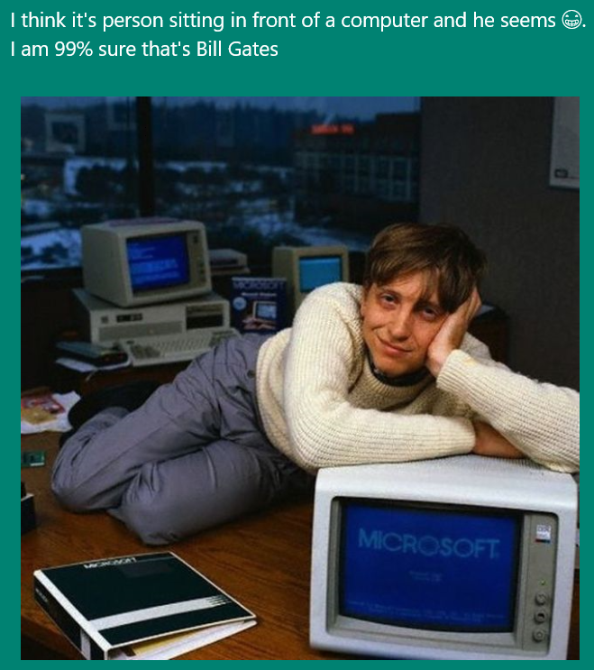
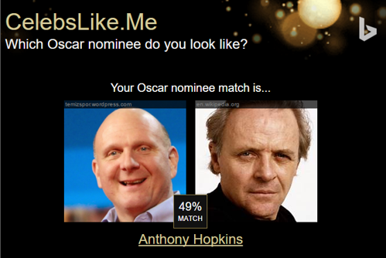

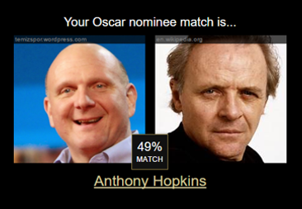
Apps Powered by MS Cognitive Services
I think it’s a person sitting in front of a computer and he seems ☺. I am 99% sure that’s Bill Gates
CaptionBot.ai
Celebslike.me
ProjectMurphy.net

Slide 10







Why Microsoft Cognitive Services ?
Easy
Flexible
Tested
Roll your own with REST APIs
Simple to add: just a few lines of code required
Make the same API code call on iOS, Android, and Windows
Integrate into the language and platform of your choice
Built by experts in their field from Microsoft Research, Bing, and Azure Machine Learning
Quality documentation, sample code, and community support
GET A KEY
BUILD

Slide 11

Cognitive Services
microsoft.com/cognitive
Vision
Speech
Language
Knowledge
Search
Computer Vision
Custom Recognition
Bing Spell Check
Academic Knowledge
Bing
Web Search
Emotion
Speaker Recognition
Linguistic Analysis
Entity Linking
Bing
Image Search
Face
Speech
Language Understanding
Knowledge Exploration
Bing
Video Search
Video
Translator
Text Analytics
Recommendations
Bing
News Search
WebLM
Bing
Autosuggest

Slide 12
Cognitive Services
microsoft.com/cognitive
Vision
Speech
Language
Knowledge
Search
Computer Vision
Custom Recognition
Bing Spell Check
Academic Knowledge
Bing
Web Search
Emotion
Speaker Recognition
Linguistic Analysis
Entity Linking
Bing
Image Search
Face
Speech
Language Understanding
Knowledge Exploration
Bing
Video Search
Video
Translator
Text Analytics
Recommendations
Bing
News Search
WebLM
Bing
Autosuggest

Slide 13
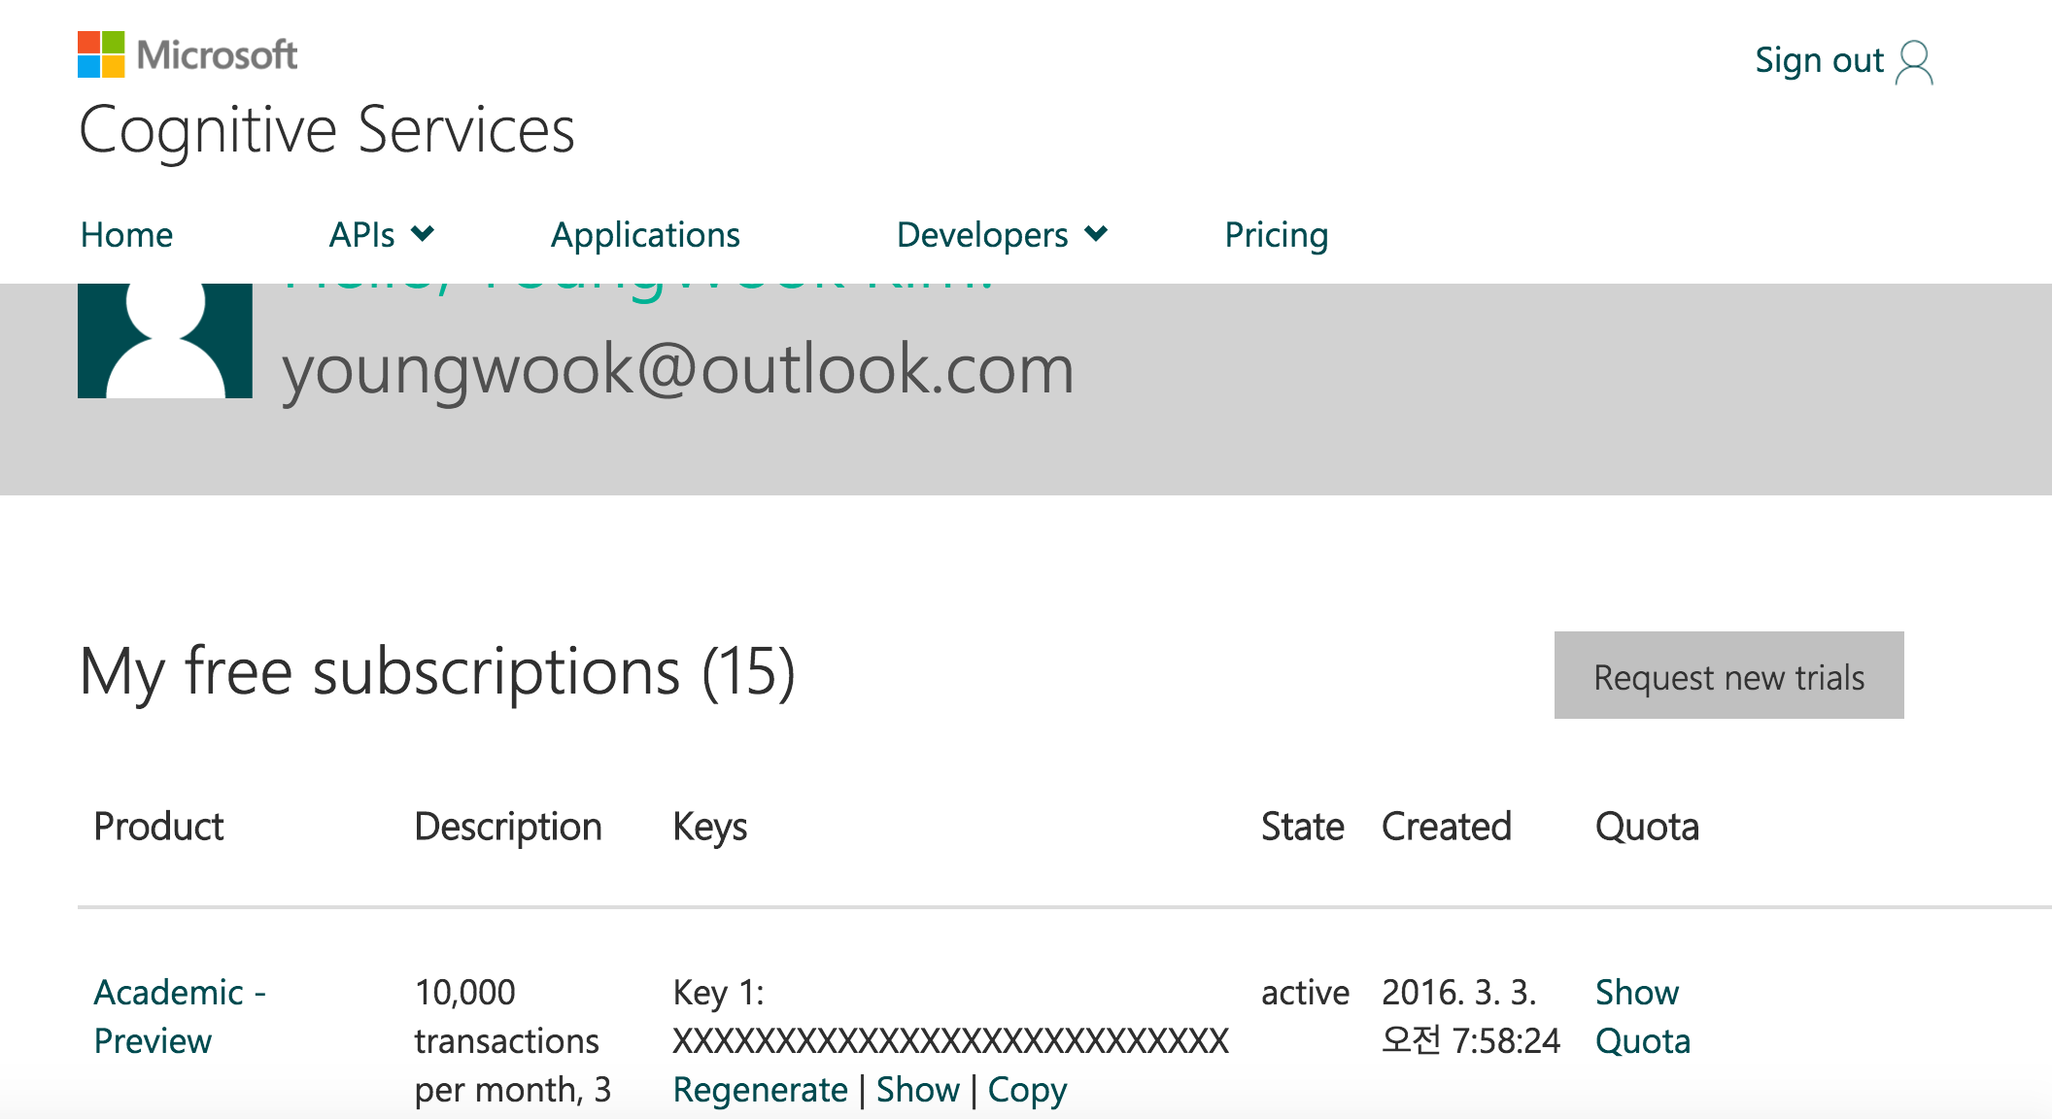
{Subscription Key}

Slide 14
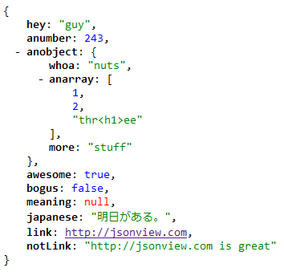

JSON
http://www.json.org/json-ko.html

Slide 15
Vision API Computer Vision Emotion Face

Slide 16
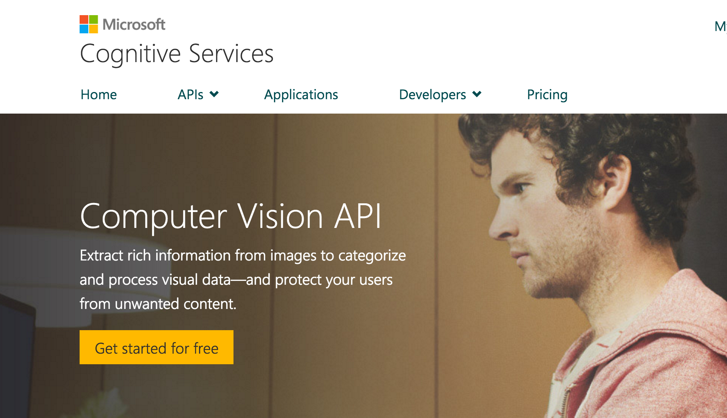

Slide 17
Demo

Slide 18
Language Bing Spell check Language Understanding Linguistic Analysis Text Analytics WebLM

Slide 19
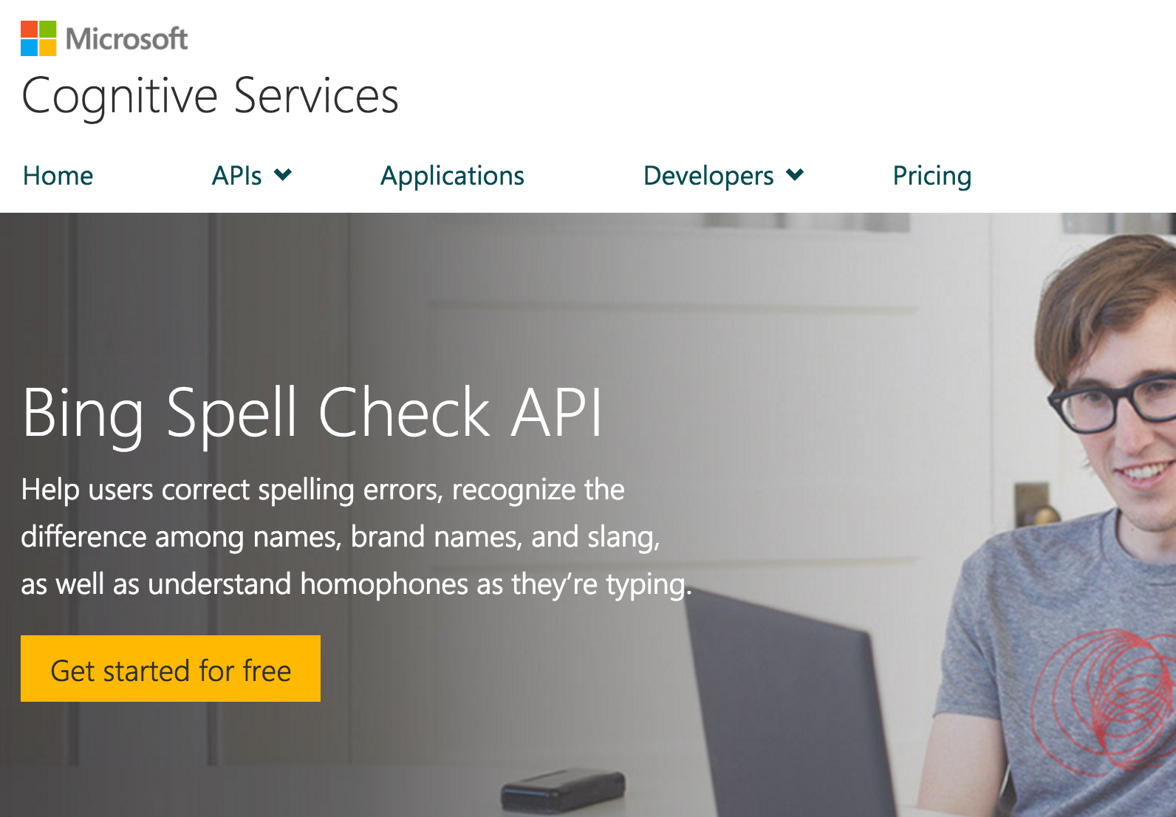

Slide 20
Demo

Slide 21
Bing Bing Web Search Bing Image Search Bing Video Search Bing News Search Bing Autosuggest

Slide 22













Bing beyond search in bing.com
Smarter, more engaging experiences
Trusted by industry-leading experiences
apple

Slide 23








Introducing Bing Search API v5
Search API v5
Web Search
Enhanced Search and Filtering Capabilities
Image Search
Web-
Scale
Secure (HTTPs)
High Performance
Video Search
News Search
REST
Autosuggest
Ongoing Improvements and Support
Spell Check

Slide 24
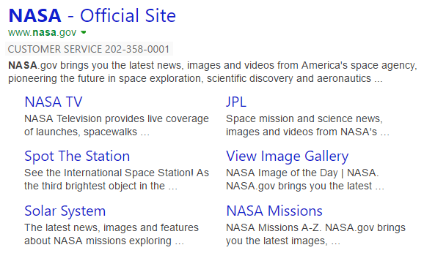

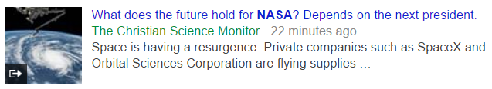

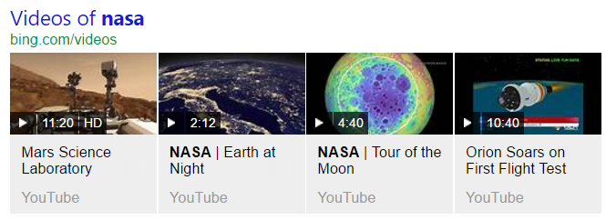
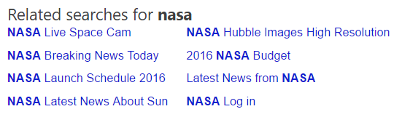
Web Search API
Web Search API
Get relevant web and answer results and metadata with one API call
https://bingapis.azure-api.net/v5/search?q=nasa
Web
Results
Search Response
Deep Links
(1st Algo)
{
“_type”: “SearchResponse”,
“queryContent”: {…},
“webPages”: {…},
“news”: {…},
“images”: {…},
“videos”: {…},
“relatedSearches”: {…},
“rankingResponse”: {…}
}
News Results
Ranking Response
Image
Results
{
“answerType”:”WebPages”,
“resultIndex”:0,…
},
{
“answerType”:”News”,
“resultIndex”:1,…
}
Video Results
Related Searches
*screenshots show actual search results on bing.com

Slide 25

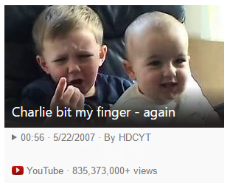

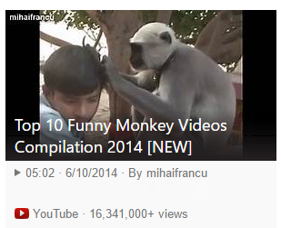
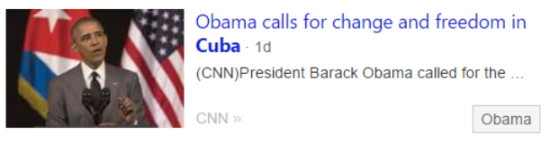
Vertical Search APIs
Get more results, features and metadata tailored to each search vertical
Image Search API
https://bingapis.azure-api.net/v5/images/search?q=shuttle+launch
Enhanced metadata and filters (size, license, style, freshness, color)
Image insights (entity recognition, visually similar)
source: nasa.gov
Video Search API
https://bingapis.azure-api.net/v5/videos/search?q=viral+videos
Enhanced metadata and filters (price, resolution, length, freshness)
Motion thumbnails (video preview)
source: youtube.com
News Search API
https://bingapis.azure-api.net/v5/news/search?q=cuba
News by category/market, and trending news
Rich article metadata (featured entities)
source: cnn.com
*screenshots show actual search results in bing.com

Slide 26
Demo

Slide 27
Developer Call to Action
Sign up and get started today for free at www.microsoft.com/cognitive

